Slide 1
Optimize your Windows Server
Sonia Cuff & Orin Thomas

Slide 2
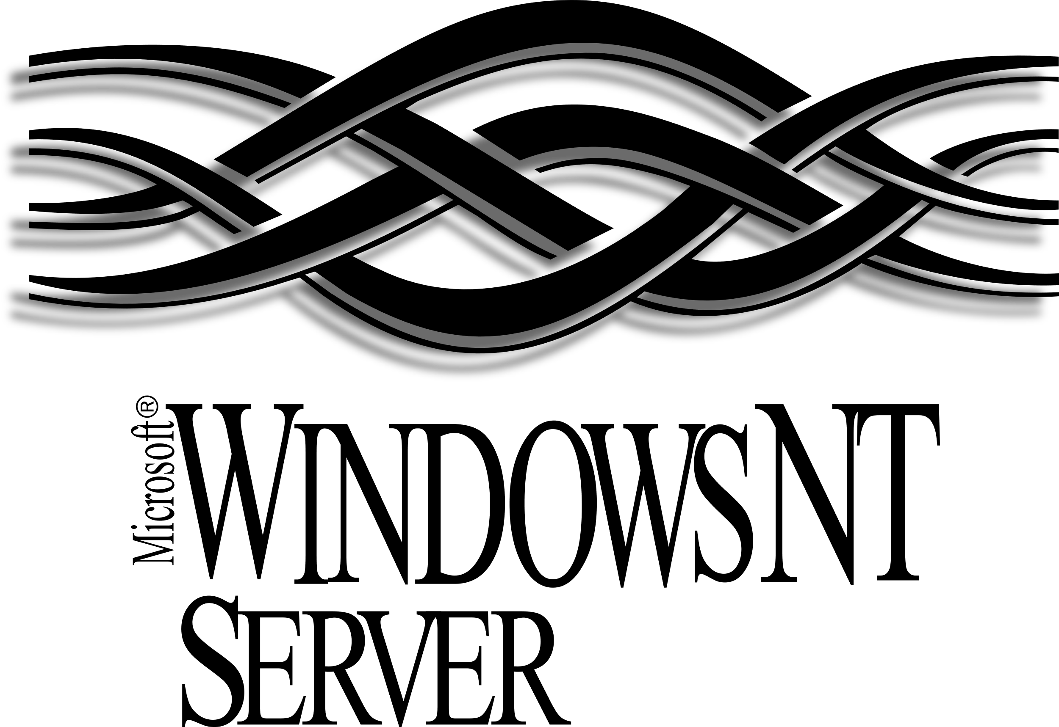
Established 1993

Slide 3
Infrastructure workloads
Identity: Active Directory
Networking services: DNS, DHCP
File sharing
Remote Desktop Services
Microsoft application hosting: e.g. Exchange, SharePoint
Databases: e.g. SQL Server
Custom application hosting
Container hosting
Website hosting

Slide 4
Agenda
Modernize the operating system version
Secure with operating system settings
Optimize file shares

Slide 5
Plan for End of Support deadlines in 2022 and 2023
July 9, 2022
SQL Server 2008, 2008 R2 Extended Security Updates end
January 10, 2023
Windows Server 2008 and 2008 R2 Extended Security Updates end
October 10, 2023
Windows Server 2012 and 2012 R2 End of Support
July 12, 2022
SQL Server 2012 End of Support
Notes:
Here’s a look at the deadlines ahead.
The deadlines include end of Extended Support for SQL Server 2012 and Windows Server 2012 and 2012 R2. Because the database is often tied to one or more applications running on Windows Server, it makes sense to look at both as you build your EOS plan. You can continue to use Windows Server 2012 and 2012 R2 safely in your environment’s architecture, at least until the extended support expiration date.
As you may know, Microsoft backs each server version with a minimum of 10 years of support (five years for Mainstream Support and five years for Extended Support) that include regular security updates.
Many customers went through the end of support exercise when Microsoft ended its support for the 2008 server versions. Here’s what happened then:
Many customers moved Windows Server and SQL Server 2008/R2 workloads to Azure VMs. Microsoft has provided free Extended Security Updates for those workloads in Azure VMs.
Other customers upgraded on-premises to Windows Server 2022 and the latest SQL Server.
If you put off action, however, you miss out on new security and efficiency features that could easily justify a move – either to Azure or the latest server release. Take the time to assess your options and make decisions that are right for your organization. With the right strategies, you can make sure your organization is protected and your infrastructure secure.

Slide 6
Demo
Migrate a Windows Server 2008 R2 File Server to
Windows Server 2022 (Server Core)
Notes:
Common file server problems:
Data = one of most critical assets. Attackers encrypt, exfiltrate & ransom file server data. Ransomware.
Outdated operating systems
Share and File/Folder Permissions inappropriately applied. File share sprawl
File lifecycle management / retention. Always running out of space.
Challenges of file server migrations
Disadvantages of in-place upgrades.
How to ensure that all data transferred is most up-to-date?, permissions are captured? all utilized shares? preserve file server identity? (name, IP address) are preserved? machine local accounts?
DFS:
How do you find a file when there’s multiple file shares on multiple servers?
DFS! Collect file shares off a single tree independent of the server any individual share is hosted on
Benefits of Storage Migration Services

Slide 7
Securing with operating system settings
Secure network communication
Harden Active Directory
Secure the operating system
Notes:
Ransomware and file servers.
Controlled Folder Access
Microsoft Defender for Servers https://learn.microsoft.com/en-us/azure/defender-for-cloud/defender-for-servers-introduction
When using Azure File Sync, there are three different layers of encryption to consider:
Encryption at rest for data stored in Windows Server. There are two strategies for encrypting data on Windows Server that work generally with Azure File Sync: encryption beneath the file system such that the file system and all of the data written to it is encrypted, and encryption within the file format itself. These methods are not mutually exclusive; they can be used together if desired since the purpose of encryption is different.
Encryption in transit between the Azure File Sync agent and Azure. Azure File Sync agent communicates with your Storage Sync Service and Azure file share using the Azure File Sync REST protocol and the FileREST protocol, both of which always use HTTPS over port 443. Azure File Sync does not send unencrypted requests over HTTP.
Encryption at rest for data stored in the Azure file share. All data stored in Azure Files is encrypted at rest using Azure storage service encryption (SSE). Storage service encryption works similarly to BitLocker on Windows: data is encrypted beneath the file system level. Because data is encrypted beneath the Azure file share's file system, as it's encoded to disk, you don't have to have access to the underlying key on the client to read or write to the Azure file share.
BitLocker Encrypt Windows Server Endpoint File Server volumes
https://learn.microsoft.com/en-us/windows-server/storage/file-server/smb-security
https://learn.microsoft.com/en-us/windows-server/storage/file-server/smb-secure-traffic
https://learn.microsoft.com/en-us/windows-server/storage/file-server/smb-interception-defense?tabs=group-policy

Slide 8
Secure the operating system
Use Server Core installation
Only install necessary roles and features
Limit administrator access
BitLocker Encryption
Windows Defender Application Control
Microsoft Defender for Servers
Secured-core Server
Notes:
Ransomware and file servers.
Controlled Folder Access
Microsoft Defender for Servers https://learn.microsoft.com/en-us/azure/defender-for-cloud/defender-for-servers-introduction
BitLocker Encrypt Windows Server Endpoint File Server volumes

Slide 9
Harden Active Directory
Domain controllers are WS2022
Audit & disable NTLM
Minimize Domain Admins
Implement Group Managed Service Accounts (GMSA)
Use Local Admin Password Solutions (LAPS)
Microsoft Defender for Identity
Notes:
Ransomware and file servers.
Controlled Folder Access
Microsoft Defender for Servers https://learn.microsoft.com/en-us/azure/defender-for-cloud/defender-for-servers-introduction
BitLocker Encrypt Windows Server Endpoint File Server volumes

Slide 10
Secure network communication
Domain isolation policies
Used Privileged Access Workstations
Minimize communication with internet
Audit & disable SMB1
Require SMB3 encryption & signing
Notes:
Ransomware and file servers.
Controlled Folder Access
Microsoft Defender for Servers https://learn.microsoft.com/en-us/azure/defender-for-cloud/defender-for-servers-introduction
BitLocker Encrypt Windows Server Endpoint File Server volumes

Slide 11
Demo
Creating a connection security rule
Notes:
Common file server problems:
Data = one of most critical assets. Attackers encrypt, exfiltrate & ransom file server data. Ransomware.
Outdated operating systems
Share and File/Folder Permissions inappropriately applied. File share sprawl
File lifecycle management / retention. Always running out of space.
Challenges of file server migrations
Disadvantages of in-place upgrades.
How to ensure that all data transferred is most up-to-date?, permissions are captured? all utilized shares? preserve file server identity? (name, IP address) are preserved? machine local accounts?
DFS:
How do you find a file when there’s multiple file shares on multiple servers?
DFS! Collect file shares off a single tree independent of the server any individual share is hosted on
Benefits of Storage Migration Services

Slide 12
Optimize file shares
Use DNS namespaces
Configure file screen
Configure controlled folder access
Turn on deduplication
Use System Insights for capacity forecasting
Azure File Sync cloud tiering

Slide 13
Demo
Configuring file screen
Notes:
Common file server problems:
Data = one of most critical assets. Attackers encrypt, exfiltrate & ransom file server data. Ransomware.
Outdated operating systems
Share and File/Folder Permissions inappropriately applied. File share sprawl
File lifecycle management / retention. Always running out of space.
Challenges of file server migrations
Disadvantages of in-place upgrades.
How to ensure that all data transferred is most up-to-date?, permissions are captured? all utilized shares? preserve file server identity? (name, IP address) are preserved? machine local accounts?
DFS:
How do you find a file when there’s multiple file shares on multiple servers?
DFS! Collect file shares off a single tree independent of the server any individual share is hosted on
Benefits of Storage Migration Services

Slide 14
Summary: Optimize your Windows Server
Modernize the operating system version
Secure with operating system settings
Optimize file shares

